Slide 1
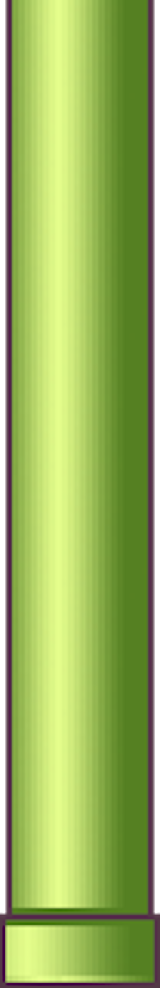

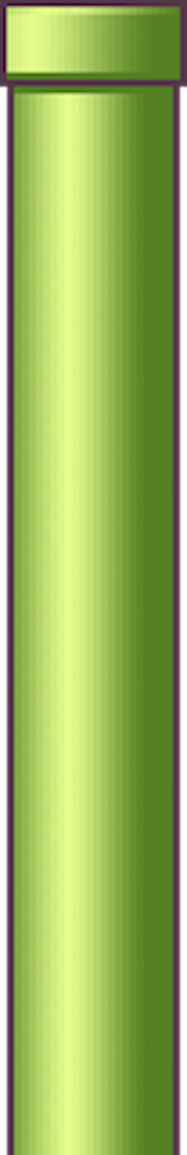
Flappy Bird Clone (Android game application)
Name: Daniel Sivaprasad
Class: FYMCA
Roll no: 10
Project guide: prof. pragati mestry
VIVA INSTITUTE OF TECHNOLOGY

Slide 2
INTROUCTION
Flappy Bird was an arcade style game developed by Dong Nguyen. Although the game was based on 2D Graphics and was very popular on both Android and iOS platforms. The purpose of the game is simple, try flying a bird, called “Faby”. between the green pipes without hitting them.
Due to its addictive nature, the game developer has suspended the game on both channels (Google Play Store and App Store)

Slide 3
Project Abstract
This project is a fully functional gaming application that runs a gaming object called flappy bird which should successfully manage the following objectives:
Moving Pipes
Score Counting
Collision detection
This project is a side scroll game based on 2D Graphics.
The goal of this project is to control the bird, avoid and pass as many obstacles as possible. This will run indefinitely until the bird hits an obstacle or the ground.

Slide 4
Existing System
In the existing system, the player controls the Faby bird, moving continuously to the right. The player is tasked with navigating Faby with a pair of pipelines with equal spaces placed on a random high point.
Faby goes down automatically and only up when the player touches the touch screen.
Each successful pass with a pair of pipes rewards the player with one point.
A collision with a pipe or a floor ends the game.

Slide 5
Disadvantages of Existing System
It quickly becomes addictive.
Frustrating when you start trying to compete.
Frustration can also cause violence or aggressive behavior.

Slide 6
Proposed System
In the proposed game design, as soon as the game begins, obstacles will keep appearing from the right side of the screen and move leftwards which will make bird seem to be flying in the forward direction.
The goal of this game would be to control the bird, dodging and passing it through as many obstacles as possible.
Try to add time limitations in the game for every day so that the users should not get too addicted to this game.

Slide 7
Technical Requirements
Software used for development
Hardware requirements
System requirements
libGDX
Android Studio
Minimum Requirements:-
Pentium processor
4GB RAM
Processor speed of 300 MHZ and above
An android device

Slide 8
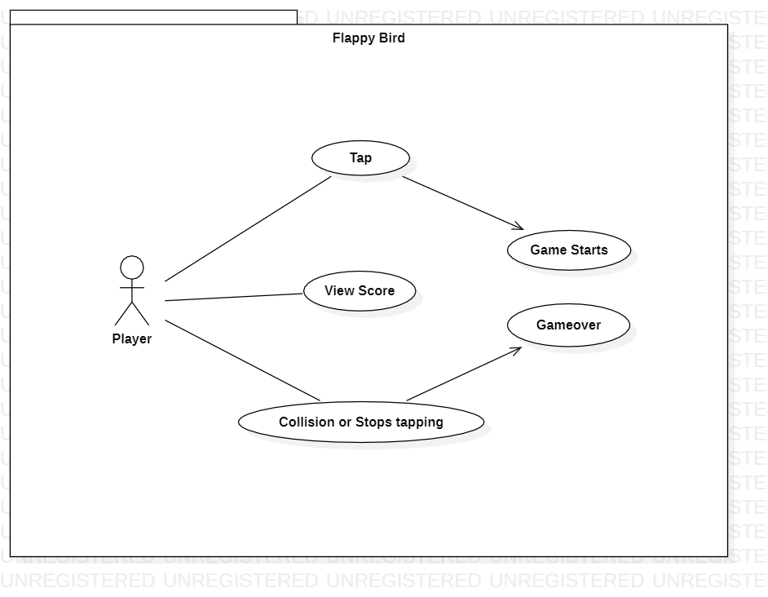
Use Case Diagram

Slide 9
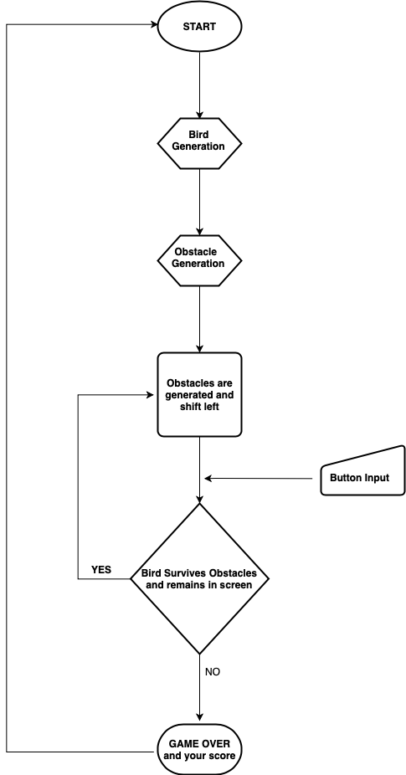
Flowchart

Slide 10
Event Table
Event | Trigger | Source | Output | Action
User opens the app | Tap | User | Game begins | Bird starts flying and obstacles(pipes) starts approaching towards the bird from the right side of the screen.
Bird hits an obstacle | Collision | User | Game Over | If bird hits any of the pipe then the game is over.
Bird hits the surface of the ground | Collision | User | Game Over | If the bird touches the ground then also the game is over
The bird crosses between the pipes. | Score | User | Score increases | The score increases as the bird keeps passing through the pipes until there is no collision.

Slide 11
Advantages
Improves mood.
Boosts your brain power.
Helps kids with Autism.
Improves Dexterity.
Improves problem solving.
Improves concentration.

Slide 12


Requirement Traceability Table
Req1 = 2D Animation
Req2 = Objectives Selection
Req3 = Moving wall
Req4 = Collision Detection
Req5 = Moving Background
Req6 = Score Counting
Requirement Test Case | Req1 | Req2 | Req3 | Req4 | Req5 | Req6
Test Case 1
Test Case 2
Test Case 3
Test Case 4
Test Case 5
Test Case 6

Slide 13
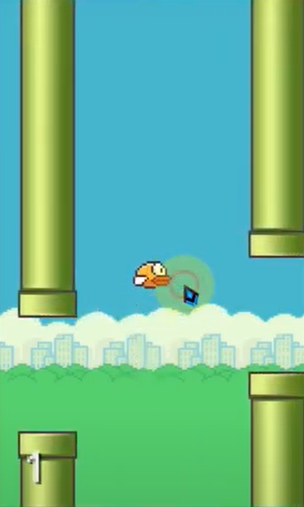
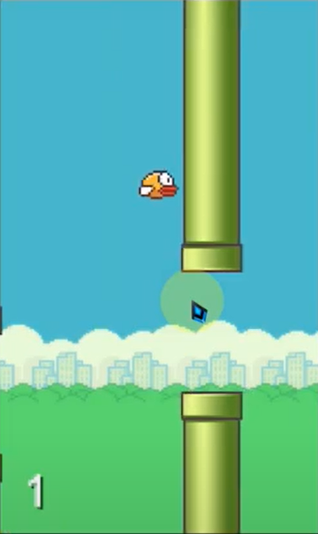
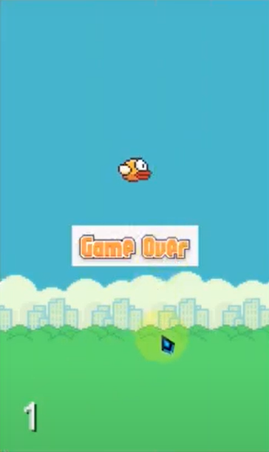
Screen Layout
1. Flying Bird
2. Before Collision
3. After Collision

Slide 14
Future Enhancement
Bird skins and backgrounds will change according to the levels and preferences of the user.
The status and history will be saved and will be displayed flexibly on a graph where the user can see his or her full performance.
Pause and Resume

Slide 15
Conclusion
Games are a type of media that is often associated with negative health effects. However, when games are played with balance and consideration, they are an effective source of stress relief and a source of mental health development and community development. Mobile games themselves are a form of modern entertainment.

Slide 16
Take Away
Improved knowledge in JAVA.
Explored libGDX game development framework.
Project Management Skills.
Experience of weekly report submission.

Slide 17
Thank you !

